Slide 1

WSP Global (TSX: WSP) Stock Pitch
CFAC Portfolio Management
Presented By: Student Investment Team - University of Calgary

Slide 2
Table of contents
01
02
03
Company Overview
Industry Overview
Investment Thesis
04
05
06
Valuation Summary
Recommendation
Appendix

Slide 3


Our team
Adelyn Keller
Bozhao Wang
Zirui Chen
Investment Analyst
Economics Graduate
University of Calgary
Business Analyst
Organizational Behaviour & Human Resources
University of Calgary

Slide 4

Company overview
01

Slide 5

Our Company
A leading Canadian professional services firm in engineering, design, and consulting
Operates across key sectors: infrastructure, transportation, environment, and energy
Headquartered in Montreal, with a global recognition in 40+ countries, employs 67,000+ professionals worldwide.
Strong emphasis on ESG (Environmental, Social, Governance) leadership & its asset-light business model.

Slide 6
Corporate Structure & Business Model
Transportation & Infrastructure
Earth & Environment
Property & Buildings
Revenue
Adjusted EBITDA
Backlog
Key End-Markets
Includes highways, rail, transit, airports, bridges, ports
Covers environmental assessments, remediation, ESG advisory
Covers commercial, healthcare, educational, and institutional projects
Revenue Scale
$16.17B
$2.19B
$15.60B

Slide 7

Strategic Positioning
ESG Leadership
Public Sector Exposure
M&A Scale Advantage
Asset-Light Model
Focused on climate-resilient infrastructure, net-zero goals, and sustainable urban design.
Stable, recurring revenues from government and infrastructure contracts, reducing cyclical risk.
Over 20 strategic acquisitions since 2019, including Golder and Wood E&I, accelerating global expansion.
Consulting-driven business enables margin expansion with low capex requirements and high EBITDA efficiency.

Slide 8

Industry Overview
02
What is WSP’s market environment, why is it attractive right now?

Slide 9

Global Infrastructure & ESG Services Market
Infrastructure Supercycle
Directly benefits from long-term spend in transportation, water, transit, and utilities.
Few Global-Scale Players
WSP competes with AECOM, Jacobs, Tetra Tech, and leads in many markets.
Rising ESG & Climate Demand
Cities need help with climate plans, Companies must meet stricter environmental rules.
Smart Infrastructure Growth
Businesses need energy-efficient buildings, WSP offers digital consulting like 3D modeling and digital twins.

Slide 10

WSP's Position in the Global Engineering Services Market
Top-Tier Global Peer Group
Balanced Geographic Exposure
Multi-discipline Consulting
M&A Helps WSP Grow Fast

Slide 11
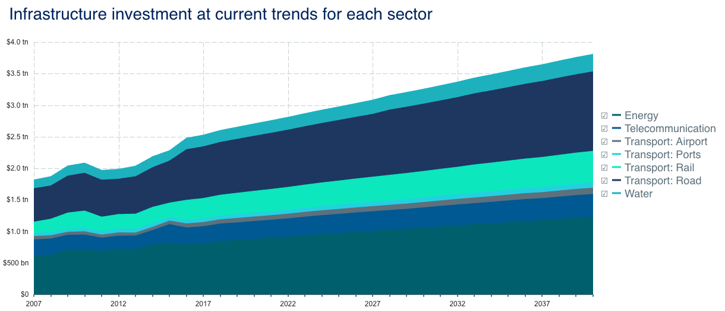
Infrastructure Investment Gap Highlights Long-Term Demand

Slide 12

Investment Thesis
03

Slide 13

Risk & Catalysts
Strong Public Exposure $15.6B backlog from repeat government & infrastructure clients.
ESG & Infrastructure Growth Well-positioned for sustainable, tech-driven urban growth.
Growth Through Acquisitions Expanding globally by buying strong firms.
Profitable Model Low-cost consulting setup drives high margins.
Valuation Upside Target price $252.54 vs. current $286.89. Upside in Bull case.
Why Buy WSP Global?

Slide 14

Risks & Mitigations
Catalysts(Upside Drivers)
Project Delays Government projects can be slow, WSP has a global mix to reduce impact.
Rising Labor Costs Higher wages could hurt profits, WSP adjusts prices and team size.
Currency Fluctuations Global operations face FX risk, WSP offsets it by natural hedging.
M&A Integration Issues Acquired companies may be hard to combine, WSP has strong track record.
Backlog Turned into Revenue.
New Project Wins.
Better Margins.
Growth by Acquisitions.

Slide 15

Valuation Summary
04

Slide 16
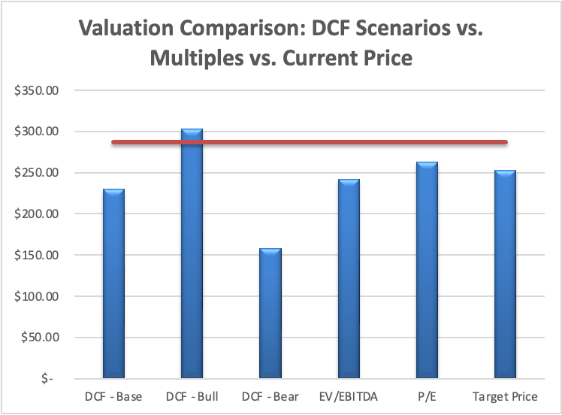
Valuation Summary – DCF & Multiples vs. Current Price
Target Price: $252.54 Current Price: $286.89 Valuation methods used:
DCF (Base, Bull, Bear)
EV/EBITDA & P/E (Peer Median Multiples)
Target = Average of EV/EBITDA & P/E methods

Slide 17
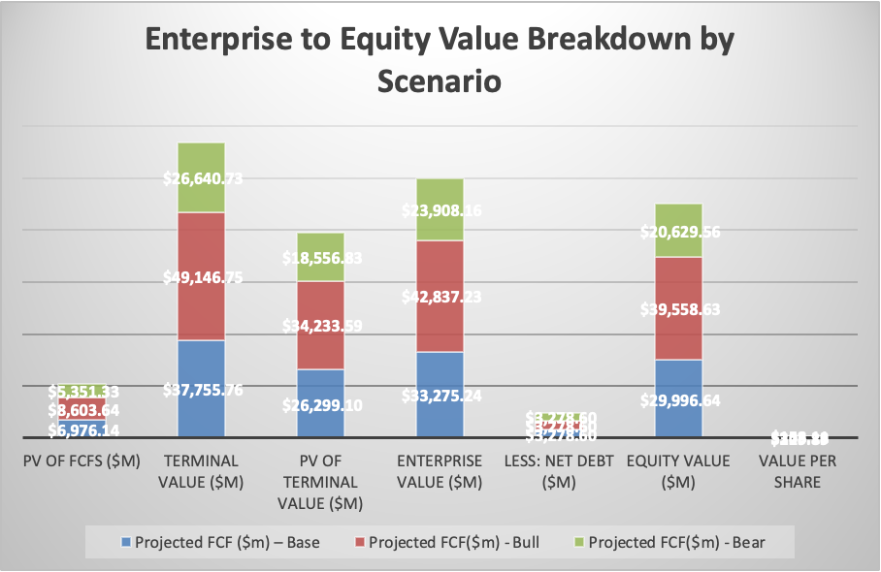
Enterprise to Equity Value – DCF Breakdown by Scenario
In all cases, terminal value makes up 75–80% of enterprise value.
Equity value is most sensitive to margin and growth assumptions.
Our base case implies $229.89/share, while the bull case supports $303.18/share.

Slide 18
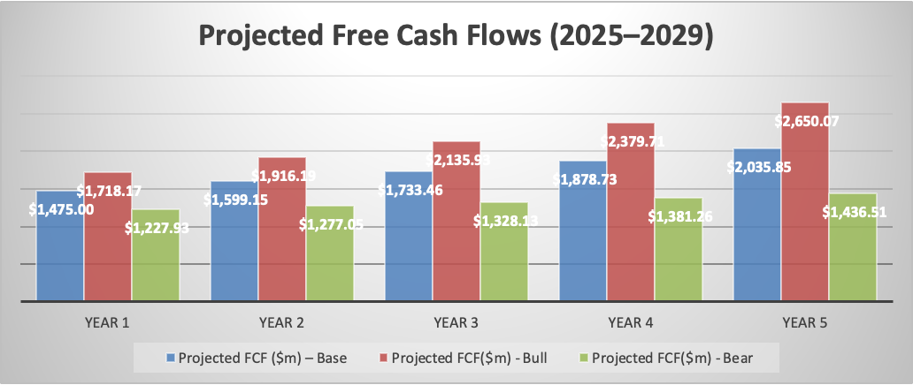
Projected Free Cash Flow (2025–2029) by Scenario
WSP is expected to grow free cash flow in all scenarios
Bull case reaches $2.65B by 2029, supporting higher valuation
Even in the bear case, cash flow stays strong — showing solid downside protection

Slide 19

WSP Value Sensitivity to WACC & Terminal Growth
This heatmap shows how WSP's base case valuation per share responds to changes in WACC (horizontal) and terminal growth rate (vertical).
Our base case assumption is WACC = 7.5% and g = 2.0%, which produces a value per share of $229.89.
Green cells indicate higher equity value — typically due to:
Lower WACC (cheaper cost of capital)
Higher terminal growth (stronger long-term outlook)
Red cells reflect more conservative scenarios with:
Higher discount rates
Slower terminal growth
This shows that WSP has upside potential, while remaining relatively resilient under more downslide assumptions.

Slide 20

05
Recommandation

Slide 21
Recommandation
1. Investment Call
Recommendation (Long-Term): BUY WSP Global (TSX: WSP)
Rationale: WSP combines strong backlog visibility, ESG leadership, and scalable margins.
Approach: Accumulate on weakness near $250–260 with upside to ~$303 in a bullish scenario.
2. Valuation Recap
Current Price (Sept 16, 2025): $286.89
DCF Base Case: $229.89
DCF Bull Case: $303.18
Comps Target (Blended): $252.54
DCF Bear Case: $158.11
3. Upside / Downside Profile
Upside (Bull Case): +5.7% vs. current
Downside (Bear Case): –45% vs. current
Target (Conservative): $252.54 implies valuation support around $250/share

Slide 22

06
Appendix

Slide 23
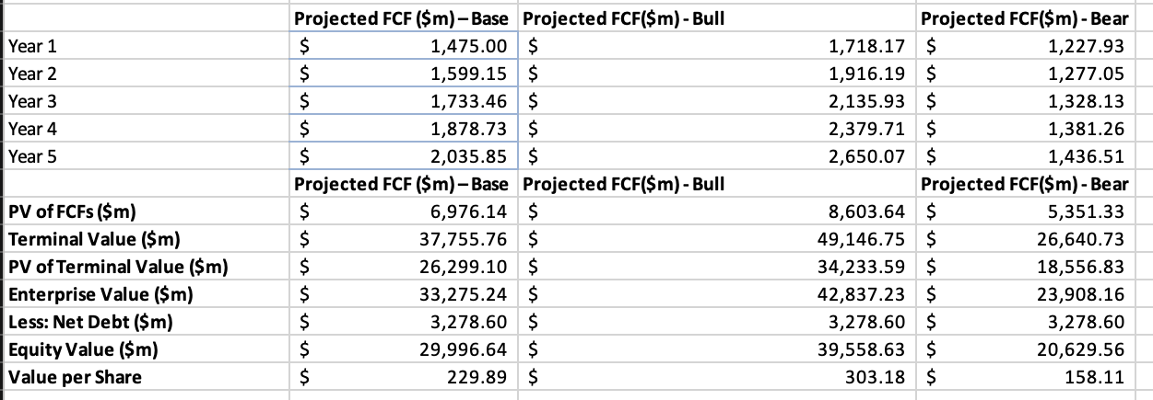
Appendix A: Free Cash Flow Forecast

Slide 24
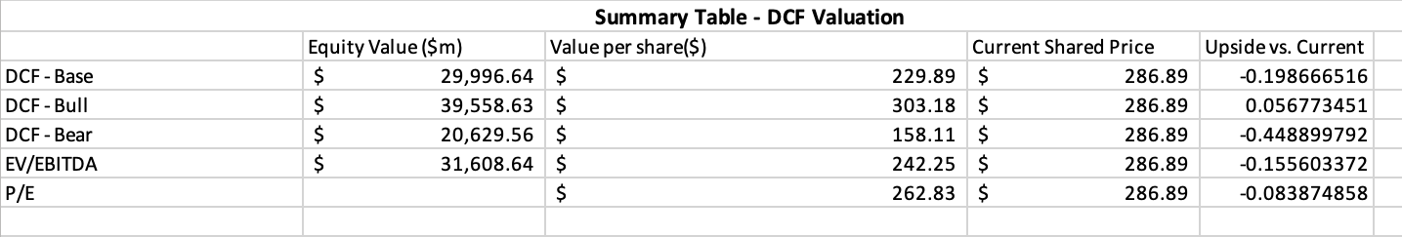
Appendix B: DCF Summary Table

Slide 25

Thanks!
Any Questions…

